Slide 1


Explore Data From Your Daily Life: cups of coffee
By Domilė Januševičiūtė, DA
Turing College

Slide 2

Contents
Introduction
Problem
How is work
Results
Question 1
Question 2
Question 3
Summary

Slide 3
INTRODUCTION: How many cups of coffee
co-workers drink
Period: 2023.09.02 - 09.08
Time: hour of the day
Co-workers: 14
Gender: women and men
Place: home or office
Cups: how many cups drink that hour per day

Slide 4
Problem
Number of cups of coffee co-workers drink daily: How often do co-workers drink coffee on weekdays?
Questions:
What times do people drink coffee most often? Is there a difference in drinking time between men and women?
On which days do co-workers drink the most cups of coffee?
Do women drink more than two cups a day?
Notes:
What would initiate me to drink more water/less coffee?

Slide 5
How it works
ASK
PREPARE
PROCESS
ANALYZE
SHARE
ACT
How many cups do you drink on weekdays and what time
Data period: 2023.09.25 - 09.29
People: 15
The data is stored in an excel program and transferred to a Google Sheet
Programs: Google Sheet (Pivot table), BigQuery
Sharing the resulting data with Turing College team

Slide 6
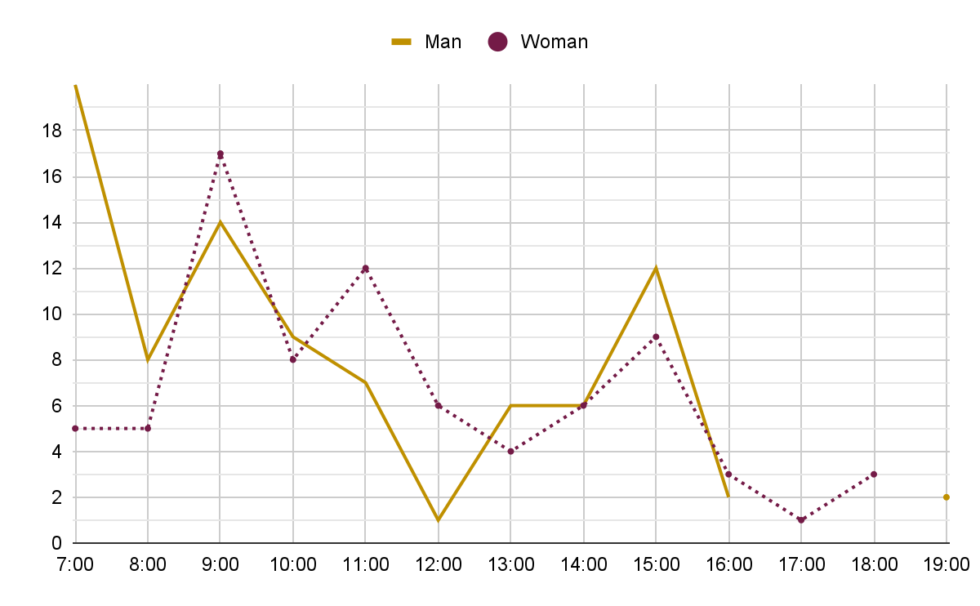
What times do people drink coffee most often? Is there a difference in drinking time between men and women?
Men and women drink cups of coffee different. Most man drink coffee at seven in the morning, at least at twelve o'clock. Women drink the most cups of coffee at 9 a.m. in the morning, and the least at 5 p.m.

Slide 7
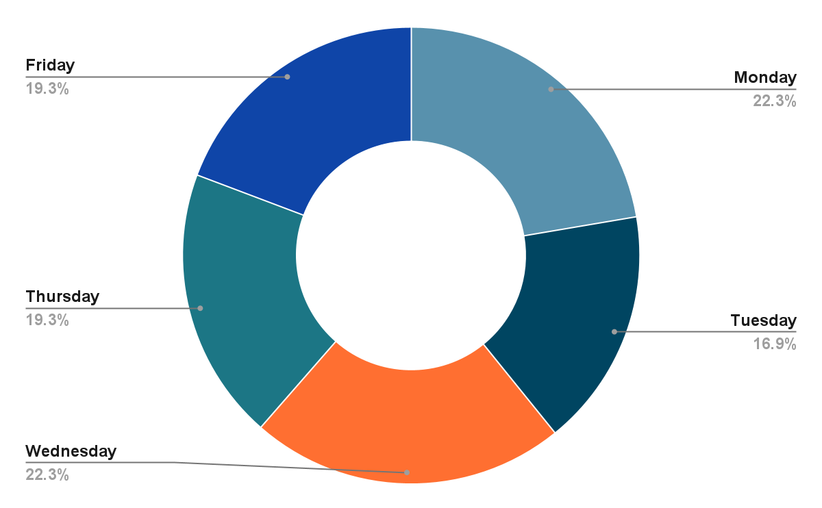
On which days do co-workers drink the most cups of coffee?
People drink more coffee on Monday and Wednesdays than on other days. Fewest people drink cups of coffee on Tuesdays. In total, fifteen people drink about 166 cups of coffee per week.

Slide 8
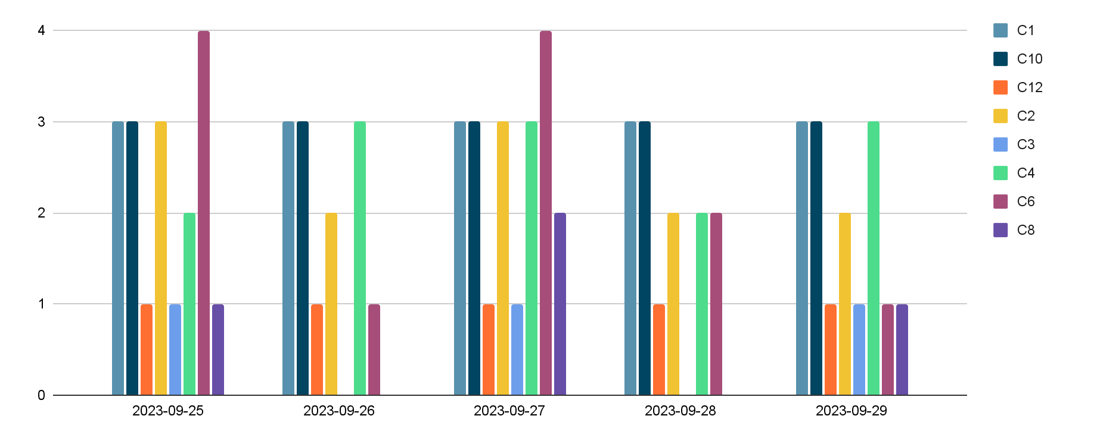
Do women drink more than two cups of coffee
a day?
Women who names are C1, C10, C2, C4 - drink two or more cups of coffee everyday. Woman - C12, C3 and C8 drink less then two cups of coffee everyday. And C6 on Monday and Wednesday drink 4 cups of coffee, on Tuesday and Friday - one, Thursday - 2.

Slide 9
SUMMARY
Almost all co-workers drink one or more cups of coffee during the workday:
When comparing men and women, the results show that women drink fewer cups of coffee than men, but it is observed that men drink coffee more in the mornings between 7 and 9 am, while women start drinking coffee the most between 9 am and 11 am.
The obtained results show that co-workers usually drink more cups of coffee on Mondays and Wednesdays.
The result of the study shows that women drink an average of two cups of coffee a day.

Slide 10
Explore Data From Your Daily Life: cups of coffee
THANK YOU
By Domilė Januševičiūtė, DA
Turing College

